Slide 1

EASYCHEF
Ronan Green

Slide 2

Introduction
Application Overview
Problem Statement
Value Proposition
Target Market
Research
Features
Conclusion

Slide 3
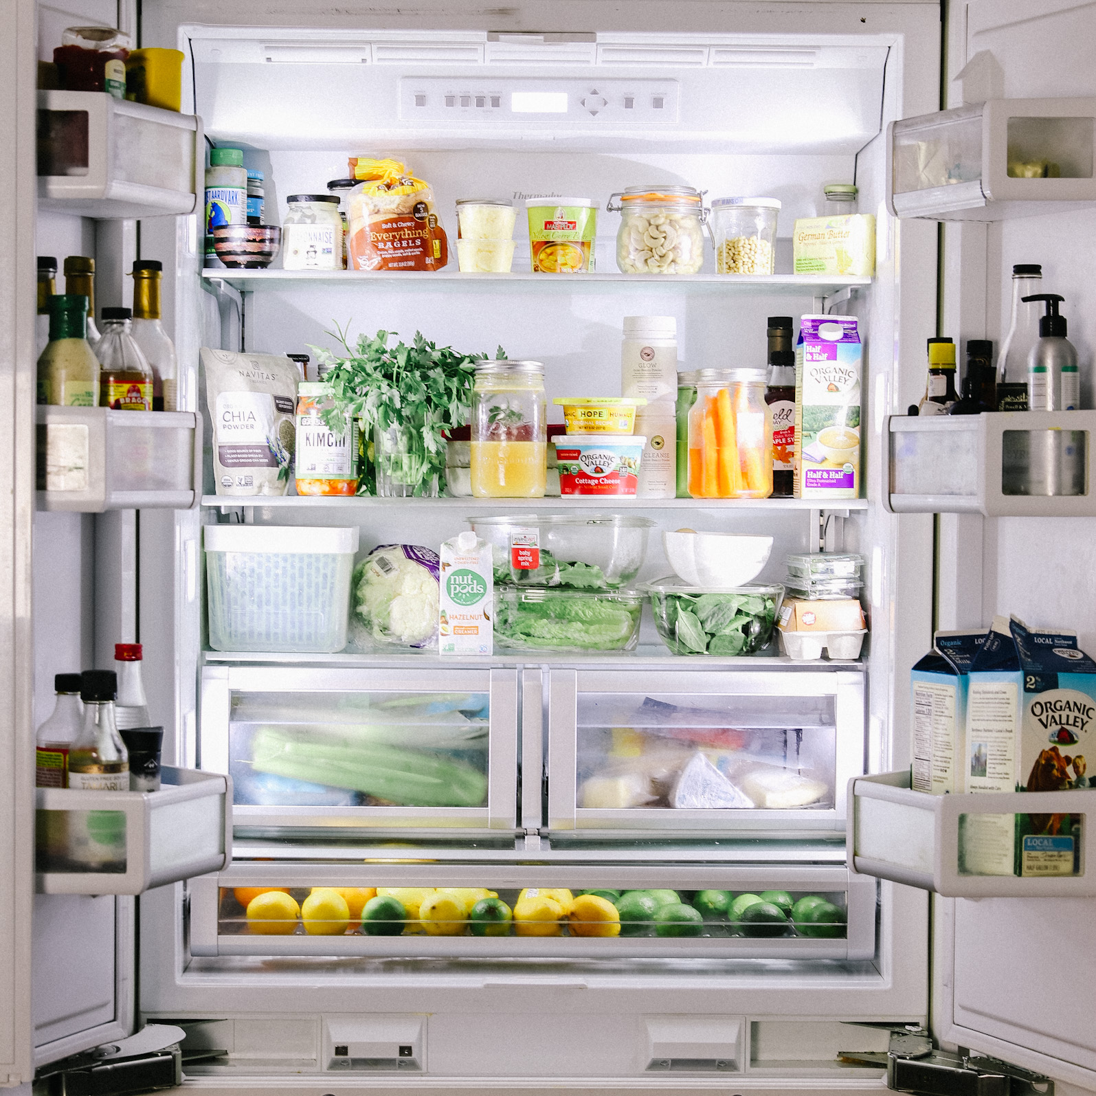
Application Overview
EasyChef simplifies meal prep and cooking.
Users can generate meals and shopping lists based on their existing ingredients.
AI-managed ingredients and personalised recipes make it all easier.
Target audience:
Busy people
Health-conscious individuals
Budget students who seek simple meals.
Objectives:
Simplify cooking
Save time in preparation
Improve ingredient utilisation

Slide 4
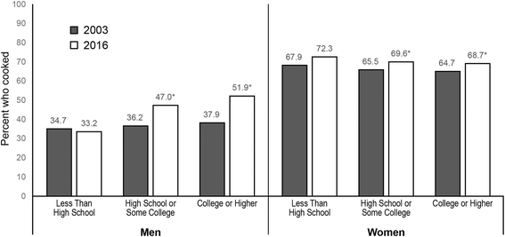
Problem Statement
Life runs at a fast pace, making it difficult to plan healthy meals with time constraints.
Home cooking is rising globally for both men and women.
Convenience foods remain popular among higher-income families but tend to be unhealthy.
Meal preparation in Ireland is a tradition where family members come together.

Slide 5
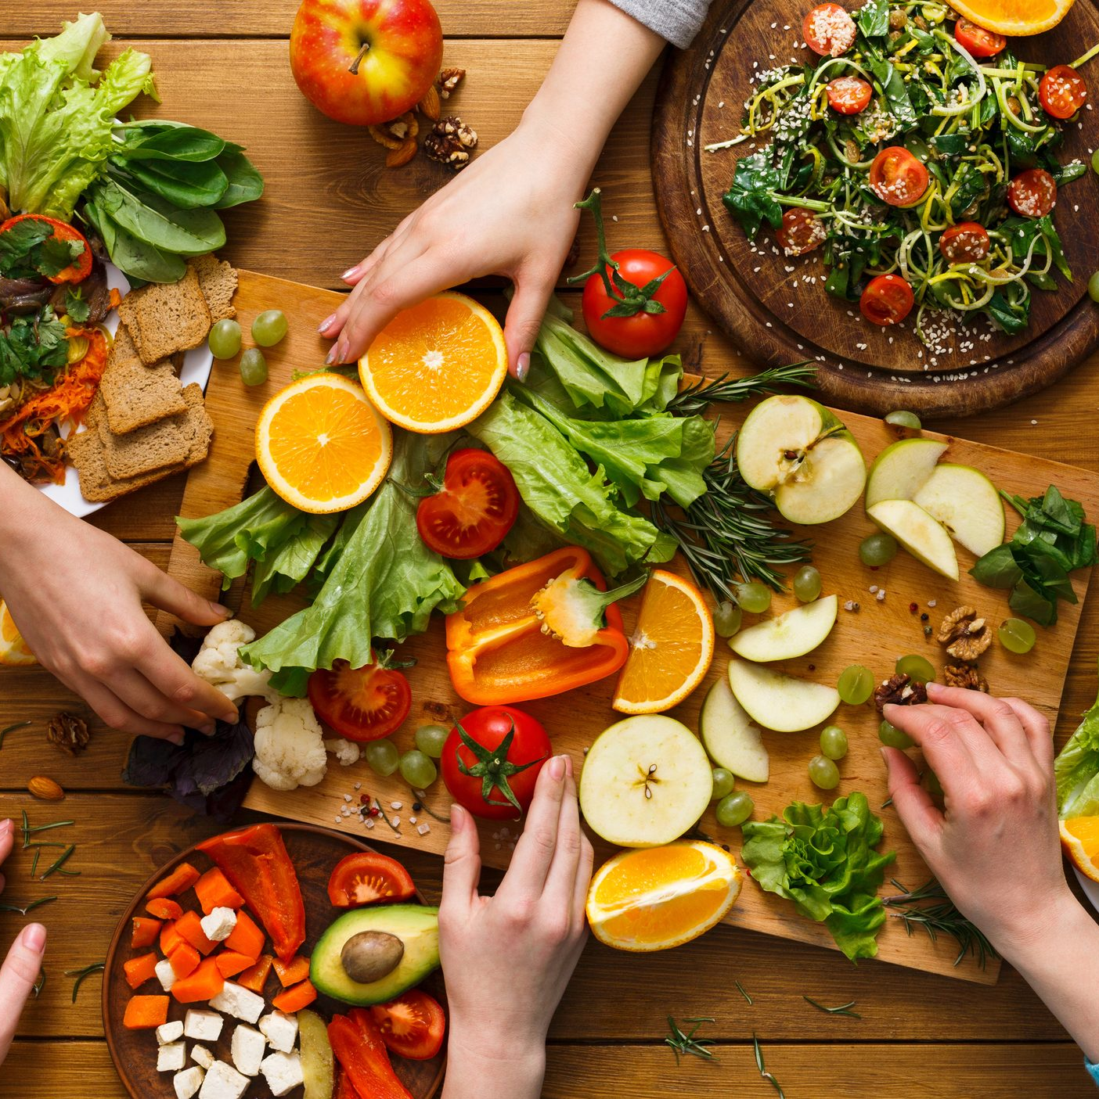
Value Proposition
EasyChef simplifies meal planning and cooking for people with busy lives.
Optimises ingredients with the help of AI and personalised recipes.
Stimulates healthy eating and reduces food waste.
Suggests healthier options for a healthier lifestyle.
Facilitates the creation of:
Shopping lists
Finding new recipes
Creating personalised diet plans.

Slide 6

Target Market
EasyChef will target:
Busy people with limited time
Students on a budget
Health-oriented individuals
People seeking ease in cooking
Will attract:
Those who want to minimise food waste
Those searching for new, easy recipes
Target audience includes anyone interested in:
Easy meal planning
Personal meal preparation

Slide 7
Research
Less time for meal planning due to busy lifestyles Rise in home cooking:
A 4% increase among educated women and a 14% increase among men [1].
Home cooking increased by 42%, with 60% continuing this habit post-lockdown [2].
Takeaways as a common alternative:
Higher consumption in higher-income households [3].
New Zealand show takeaways have high energy content and low nutritional quality[4].
Cultural importance of home cooking in Ireland:
75% of Irish parents learned cooking skills from their mother [5].
Home cooking connects families to their food [6].

Slide 8

Features
EasyChef offers a variety of core features to streamline cooking and meal planning.
Core features include:
Ingredient identification through image recognition
Personalised recipe recommendations
Shopping list creation
Barcode scanning
Healthy alternative suggestions
User profile for customisation

Slide 9
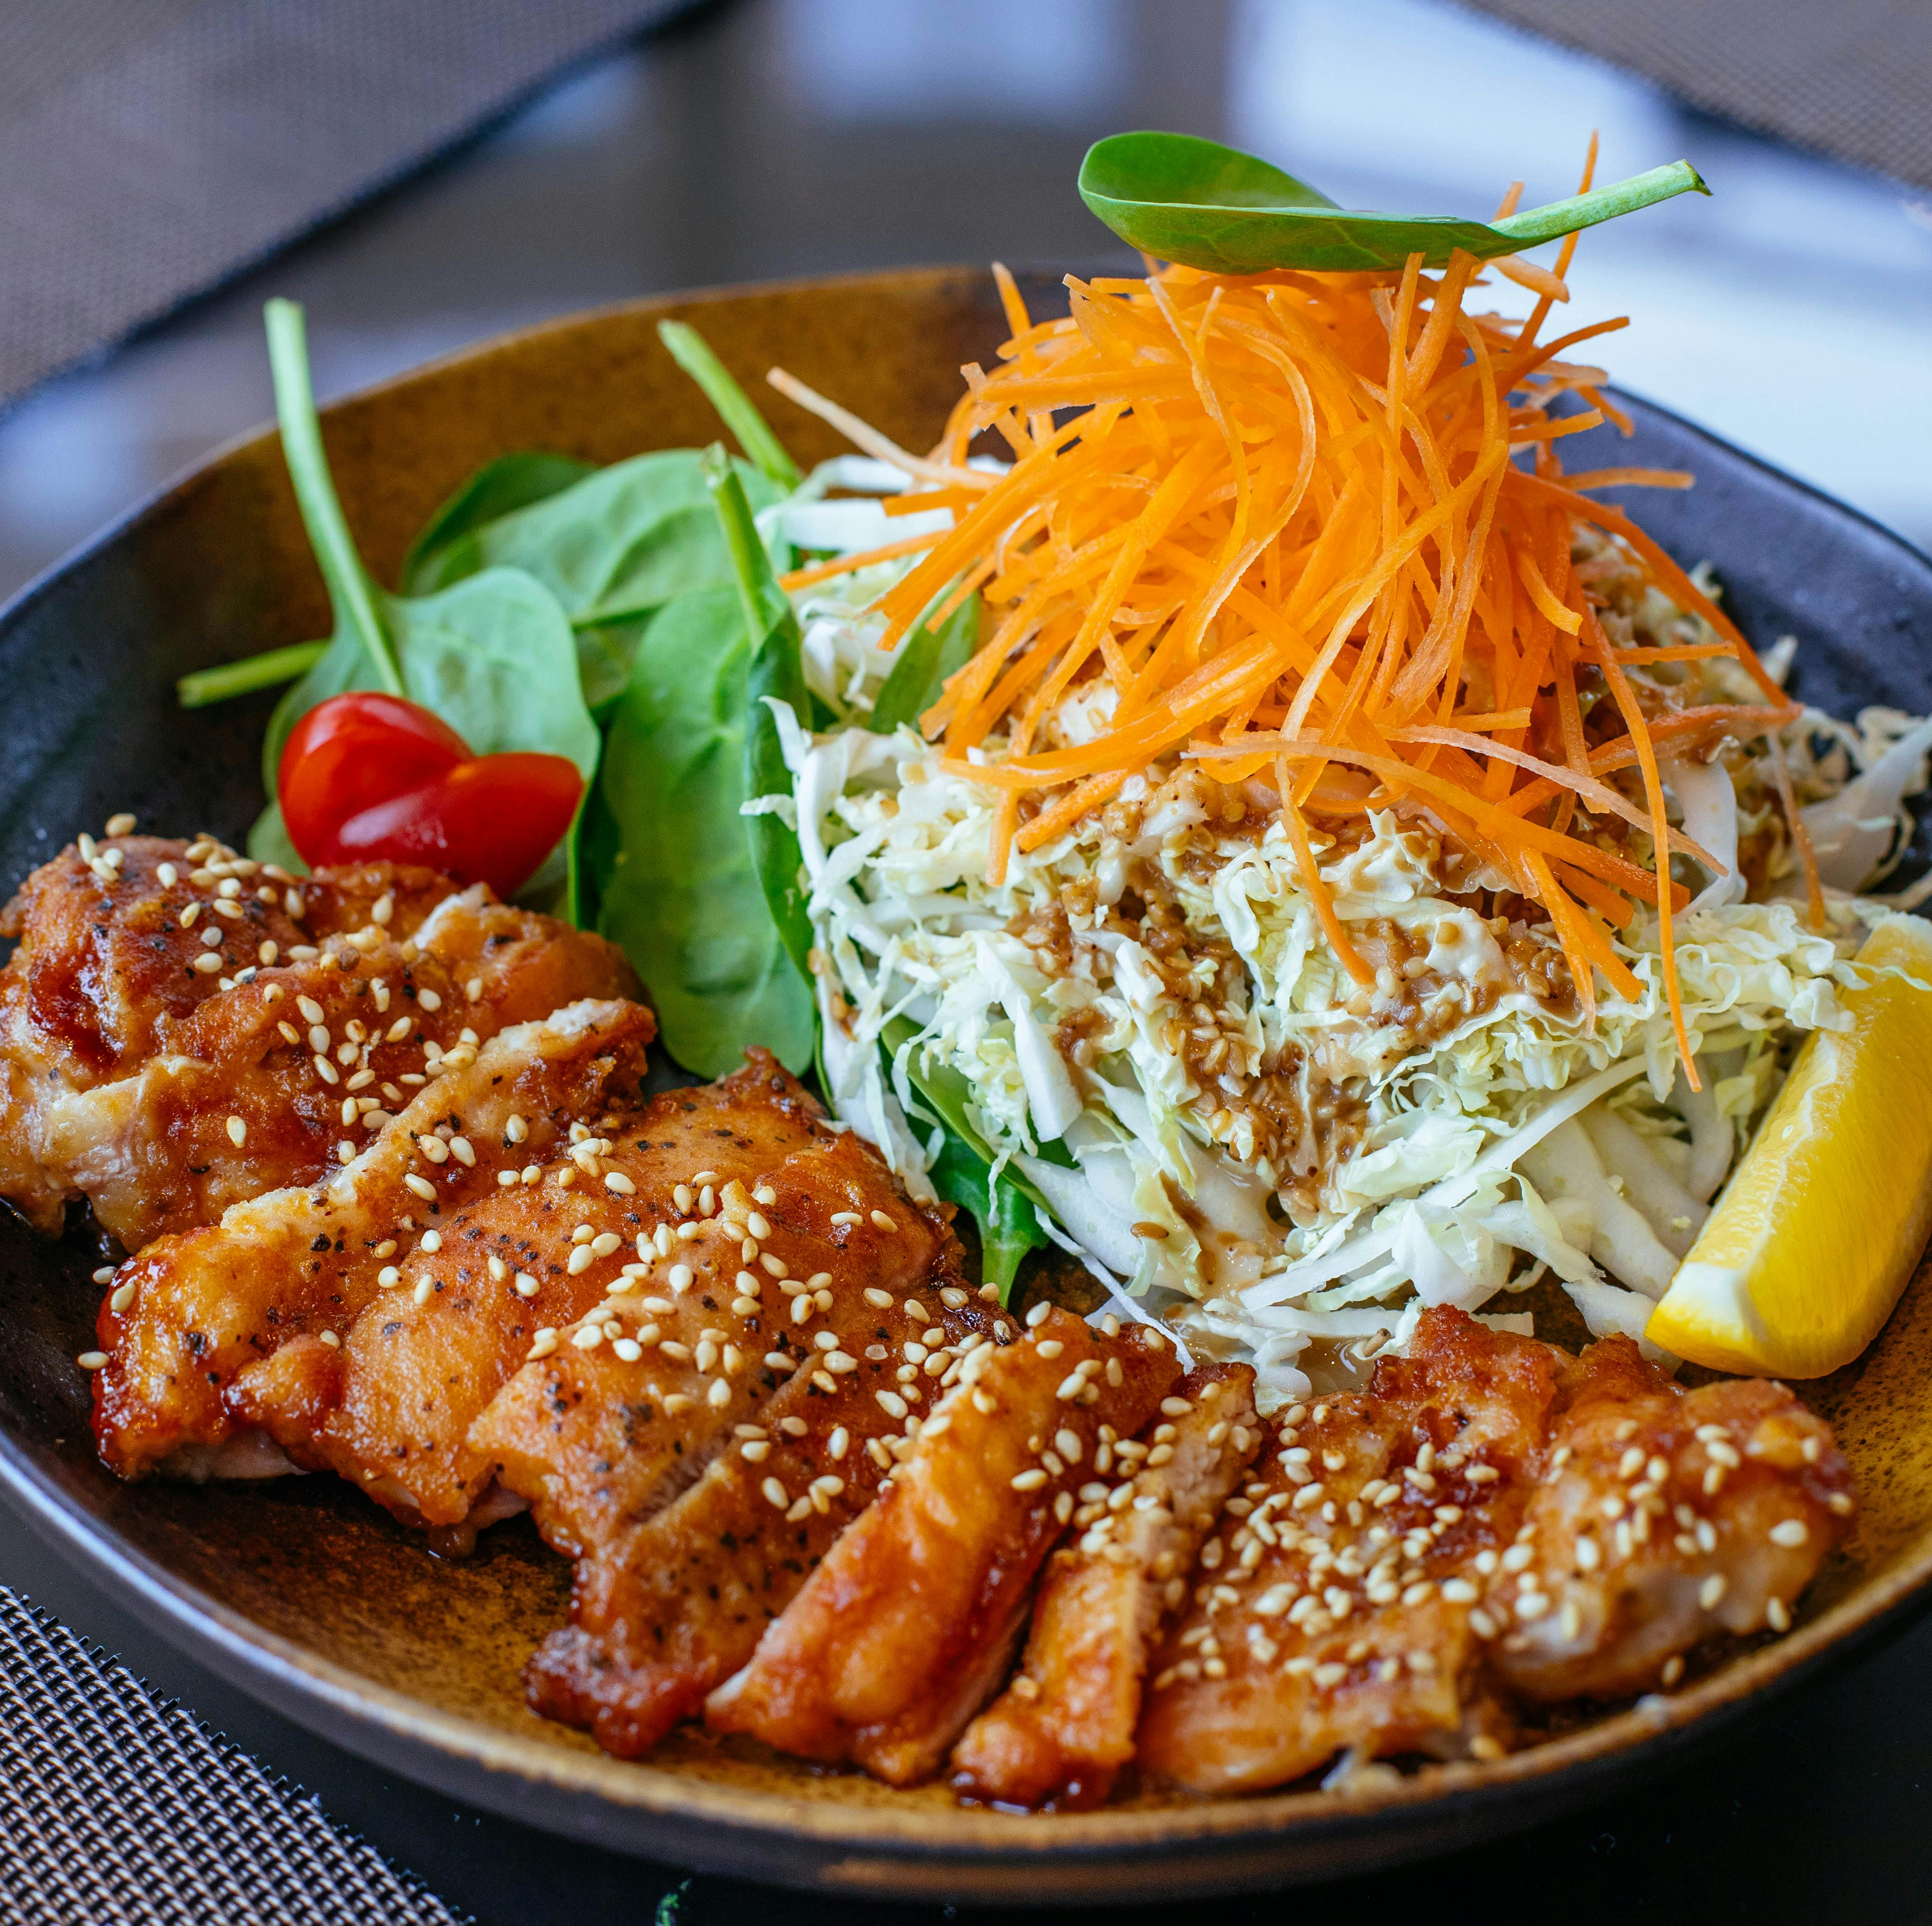
Conclusion
EasyChef is a meal planning application that uses AI and machine learning for daily convenience.
Features include:
Image recognition
Personalised recipes
Ingredient management
Provides an easy-to-use solution for cooking challenges.
Offers a new meal preparation approach for:
Busy people
Students
Home cooks
Based on a clear functional specification and user insights.

Slide 10
Refrences
[1] Taillie, L.S. (2018). Who’s cooking? Trends in US home food preparation by gender, education, and race/ethnicity from 2003 to 2016. Nutrition Journal, 17(1). doi:https://doi.org/10.1186/s12937-018-0347-9. https://link.springer.com/article/10.1186/s12937-018-0347-9
[2] Sarda, B., Delamaire, C., Serry, A.-J. and Ducrot, P. (2022). Changes in home cooking and culinary practices among the French population during the COVID-19 lockdown. Appetite, 168, p.105743. doi:https://doi.org/10.1016/j.appet.2021.105743. https://www.sciencedirect.com/science/article/pii/S0195666321006504
[3] Turrell, G. and Giskes, K. (2008). Socioeconomic disadvantage and the purchase of takeaway food: A multilevel analysis. Appetite, 51(1), pp.69–81. doi:https://doi.org/10.1016/j.appet.2007.12.002. https://www.sciencedirect.com/science/article/abs/pii/S0195666307004308
[4] Mahawar, N., Jia, S.S., Korai, A., Wang, C., Allman-Farinelli, M., Chan, V., Raeside, R., Phongsavan, P., Redfern, J., Gibson, A.A., Partridge, S.R. and Roy, R. (2022). Unhealthy Food at Your Fingertips: Cross-Sectional Analysis of the Nutritional Quality of Restaurants and Takeaway Outlets on an Online Food Delivery Platform in New Zealand. Nutrients, 14(21), p.4567. https://www.mdpi.com/2072-6643/14/21/4567 https://www.mdpi.com/2072-6643/14/21/4567
[5] McCloat, A., Mooney, E., & Hollywood, L. E. (2017). Have Irish parents put cooking on the back burner? An Island of Ireland study of the food skills, cooking confidence and practices of parents. British Food Journal, 119(5), 992-1002. https://doi.org/10.1108/BFJ-09-2016-0440 https://www.emerald.com/insight/content/doi/10.1108/BFJ-09-2016-0440/full/html
[6] Simmons, D., & Chapman, G. E. (2012). The significance of home cooking within families. *British Food Journal, 114*(8), 1184-1195. https://doi.org/10.1108/00070701211252110 https://www.emerald.com/insight/content/doi/10.1108/00070701211252110/full/html

